Slide 1
Instructor dashboard
User guide
Last update: Oct 2020

Slide 2
Your Cengage instructor dashboard
The place to find and manage ready-made teaching and learning tools for your chosen resource
Examples include:
  Chapter-by-chapter PowerPoints
  Instructors manuals
  Mapping grids
  Additional content and learning activities
  Media, including videos and simulations
  Our digital learning platforms such as MindTap
  And much, much more!

Slide 3


Getting Started
Visit au.cengage.com, click on Sign in (top right-hand corner of screen)

Slide 4
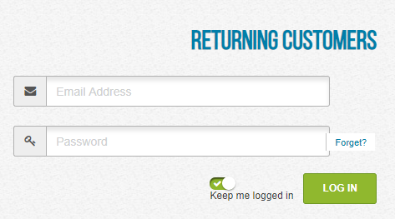

Login
Enter your login credentials
Need help?
I can’t remember my username
Try using your institutional email address. If this does not work, contact your Cengage learning consultant for assistance.
I forgot my password
If you have accessed the dashboard in the past and since forgotten your password, please contact your Cengage learning consultant.
I was never set up with a username or password
Contact your Cengage learning consultant for assistance.

Slide 5
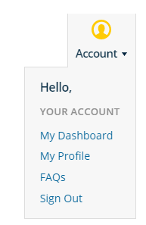
Access your resources
Click on Account and select My Dashboard

Slide 6
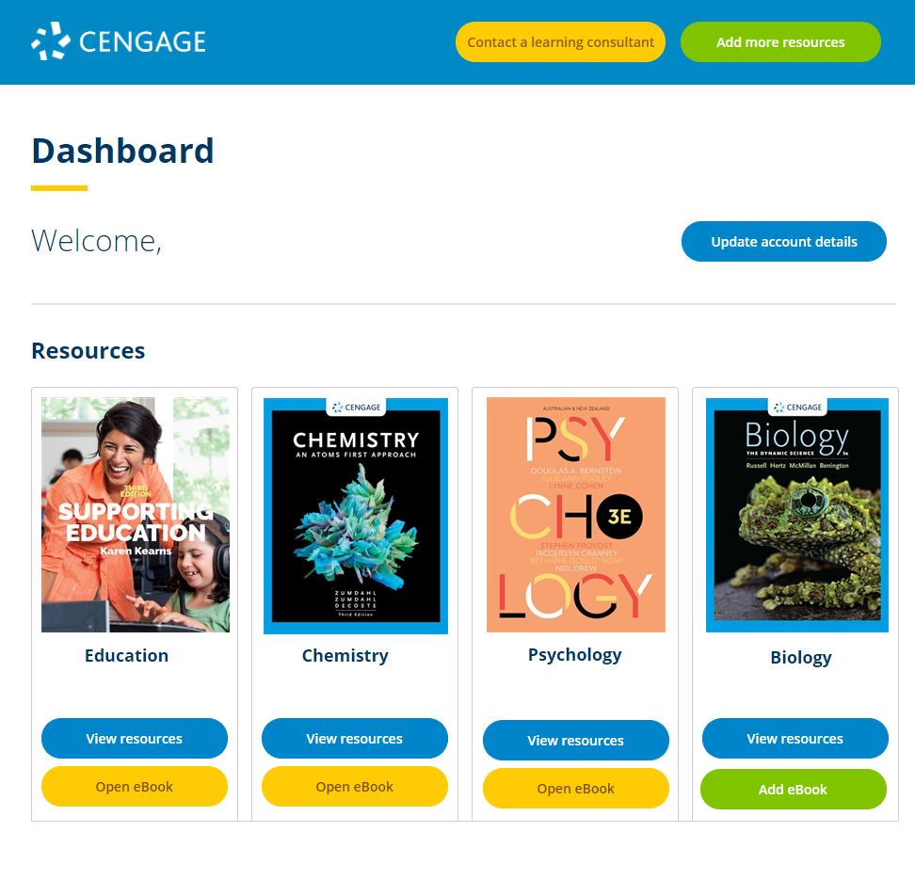
Your dashboard
Click on View resources to access teaching resources.

Slide 7
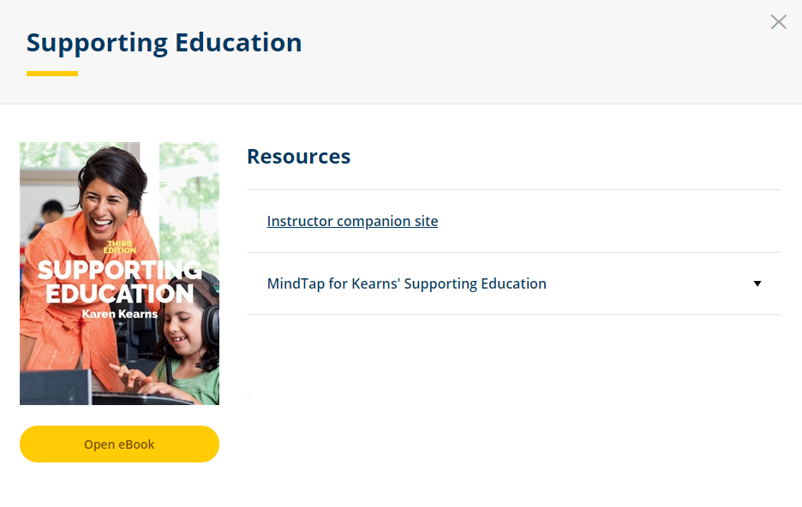
Access
Select Instructor Companion Site to get access to the available teaching tools.
Looking for more?
If you wish to know more about any of the additional learning resources available for a title, such as MindTap, or if you would like a demonstration of how they work, please contact your Cengage learning consultant.

Slide 8

Find new resources
From the dashboard, click Add more resources

Slide 9
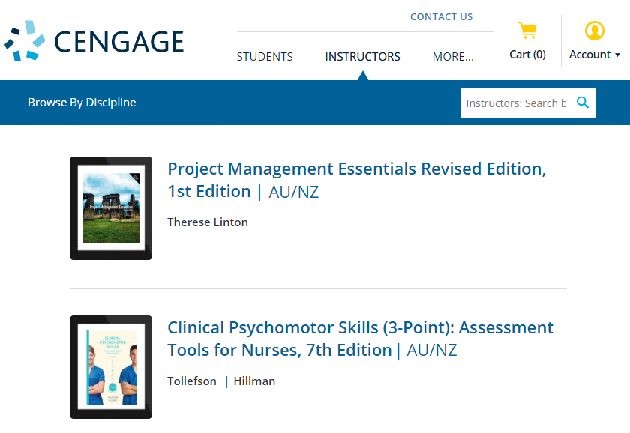
Search
Type the title, author or ISBN into the search bar.
Alternatively, you can Browse by discipline.

Slide 10
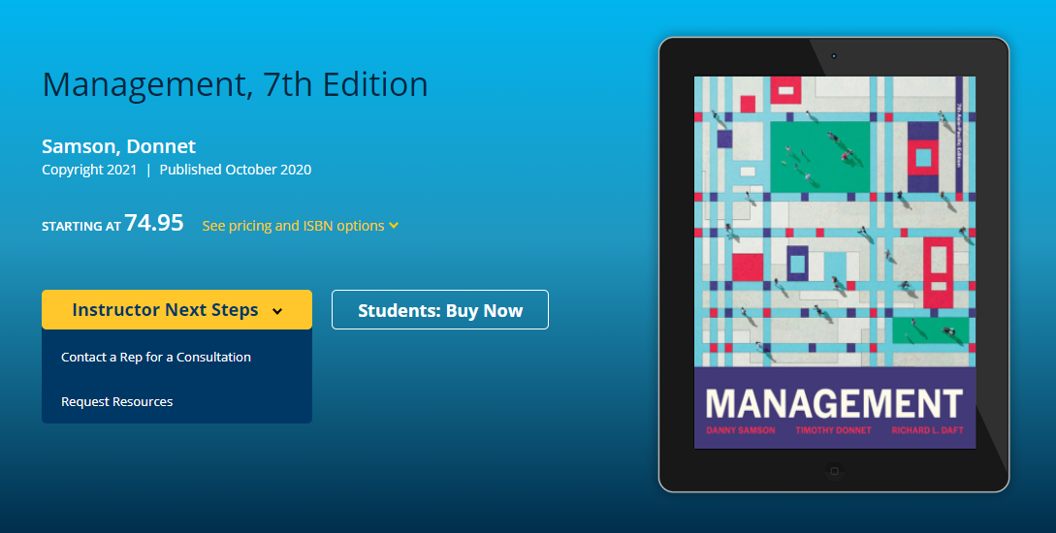
Request
Once you have found the title to review, click Instructor Next Steps and select Request Resources

Slide 11
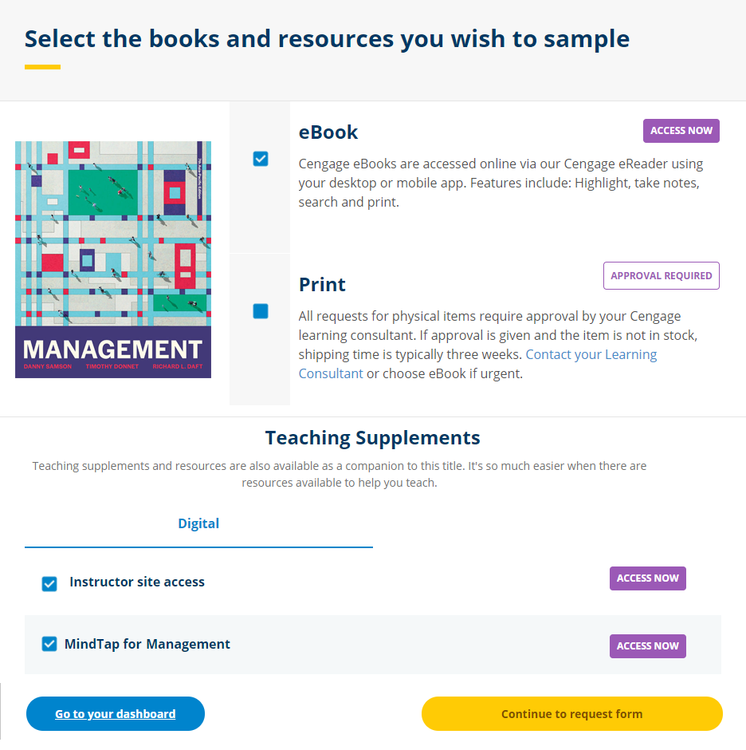
Request
Select the resources you wish to review by checking the appropriate boxes, then click on Continue to request form

Slide 12
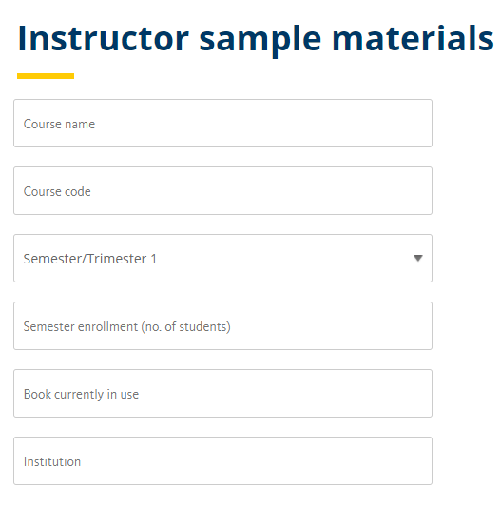
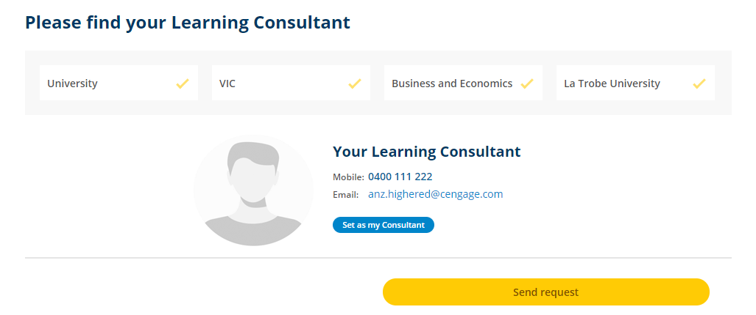
Request
Complete request form and choose your learning consultant, then hit Send request
Note:
You can use any of the drop-down options to find your Learning Consultant

Slide 13
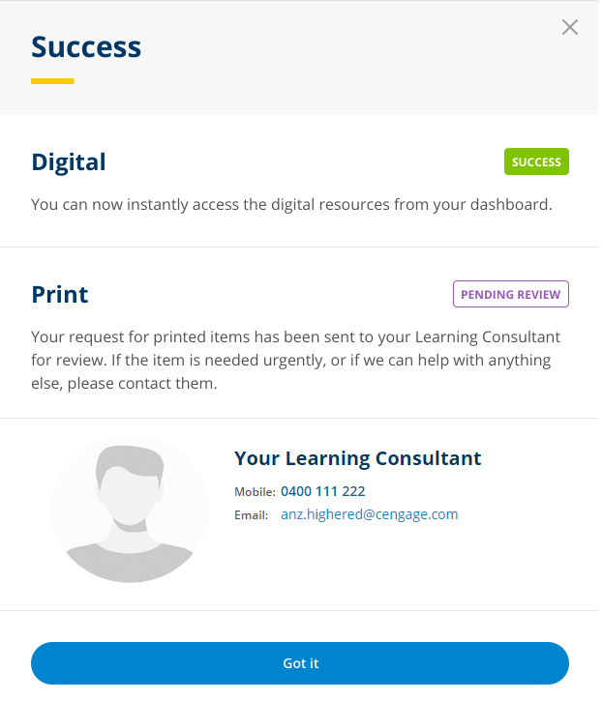
Success
Your resources will now be available on your dashboard.

Slide 14
Have Questions?
If you have any questions or require any assistance navigating the resources, please do not hesitate to contact your Cengage learning consultant

